Slide 1
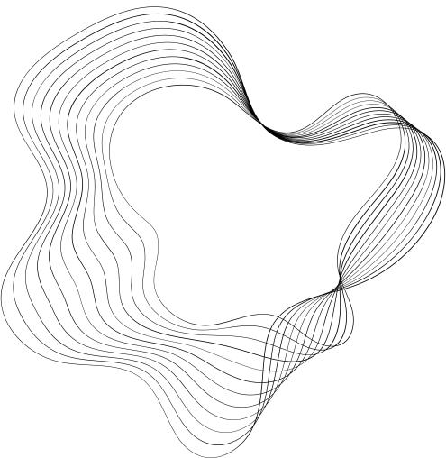

HEART ATTACK PREDICTION

Slide 2
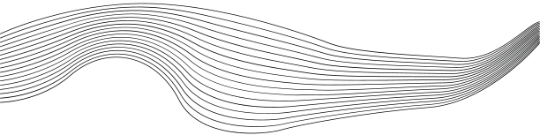
CONTENT
01
OUR TEAM
02
PROBLEM STATEMENT
03
MARKET NEED
04
BUSINESS USE CASES
05
PROJECT TIMELINE
06
INSIGHTS
07
MODELING
08
DEPLOYMENT

Slide 3
OUR TEAM
Omar Essam
Mohamed Helmy
Abdelrahman Mohamed
Abdelrahman Said

Slide 4
PROBLEM STATEMENT
Heart attacks are a leading cause of death, often due to late detection.
Traditional methods are inadequate for early risk identification, leading to preventable fatalities and higher healthcare costs.
A more accurate, data-driven solution is needed to predict risks earlier.

Slide 5
MARKET NEED
Hospitals
Insurers
Patients
All of them are seeking tools for better heart attack prevention.
Early detection reduces costs, improves outcomes, and empowers patients to manage their health proactively, creating a demand for predictive solutions.

Slide 6
BUSINESS USE CASES
Healthcare Providers: Early risk detection improves patient outcomes and reduces emergency care.
Insurance Companies: Better risk assessments lead to optimized healthcare plans and reduced claims.
Patients: Personalized insights help individuals take preventive actions and manage their heart health.

Slide 7

PROJECT TIMELINE

Slide 8

01
02
03
04
SPRINT 1
SPRINT 2
SPRINT 3
SPRINT 4
BUSINESS UNDERSTANDING
PREPROCESSING
ANALYSIS AND VISUALIZATION
FEATURE ENGINEERING
Modeling
Deployment

Slide 9
INSIGHTS

Slide 10
Questions
what’s the effect of features on the target
what’s the percentage of who in heart attack risk by the :
Diet
Country
Age
Sex

Slide 11
what’s the effect of features on the target ?

Slide 12
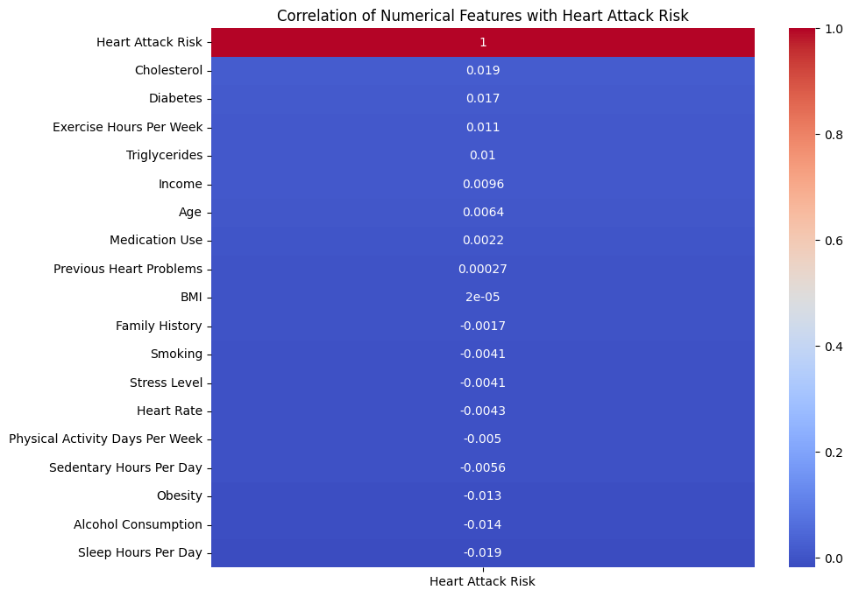

Slide 13
what’s the percentage of who in heart attack risk by these Features ?

Slide 14
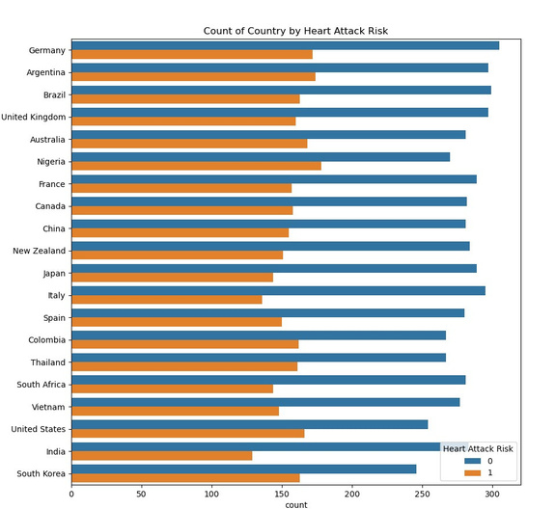
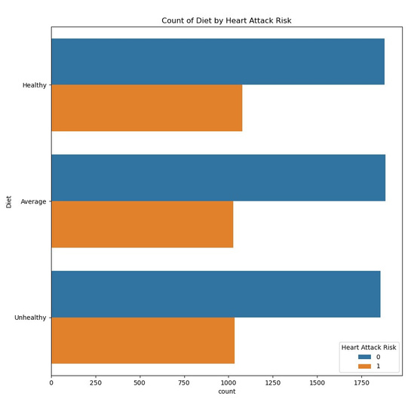
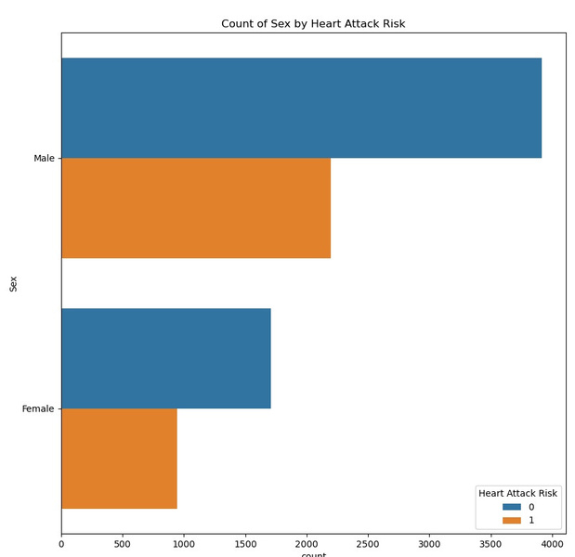
Country
Diet
Sex

Slide 15
What about the actually
in risk?

Slide 16
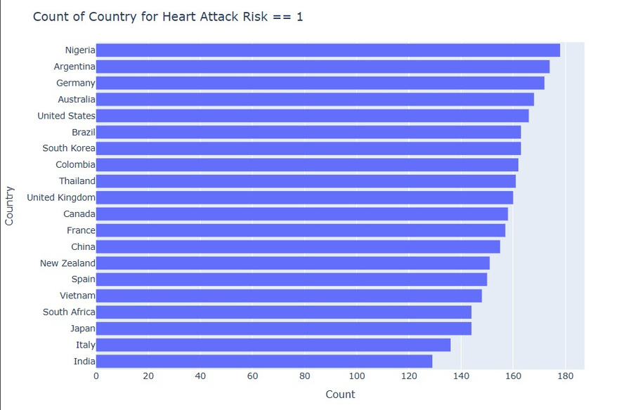
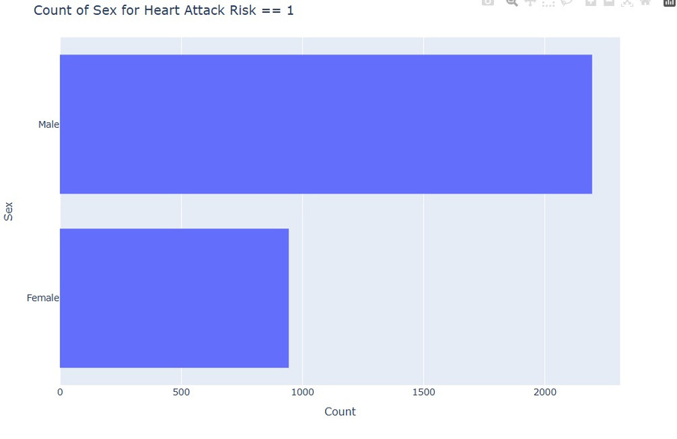
Country
Sex

Slide 17
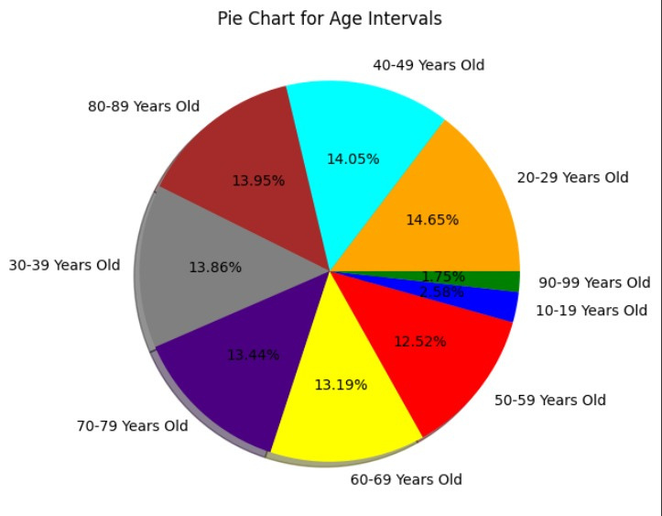
What about age ?

Slide 18
FEATURE ENGINEERING

Slide 19
Feature Engineering
handling Blood Pressure column.
Encode Categorical Features.
Standarization Numerical Features.

Slide 20
Handling Blood Pressure
Problem :
The feature “Blood pressure” is an object consisting of two part (systolic/diastolic).
Solution :
Splitting this feature into two new features “systolic_pressure” and “diastolic_pressure”.

Slide 21
Encode Categorical Features
Problem :
There are 3 Features other than “Blood Pressure” which are “Sex”, “Diet” and “Country”.
Solution :
one hot encoding to “Sex” feature .
Label encoding to “Diet” and “Country” features .

Slide 22
Standarization Numerical Features
Problem :
Select which features to make standarization and which to make min-max scaling.
Solution :
Select 10 features to do standarization and 3 features to do min-max scaling .

Slide 23
MACHINE LEARNING
MODELS

Slide 24
Machine Learning Models
Heart Attack Risk Prediction :
A binary class supervised machine learning problem .
Models used in this project :
LogisticRegression
SVC
KNeighborsClassifier
DecisionTreeClassifier
XGBoost
RandomForestClassifier

Slide 25
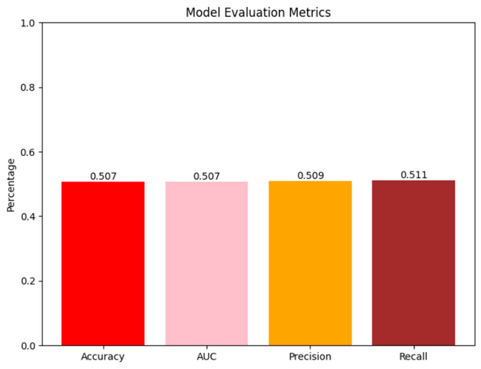
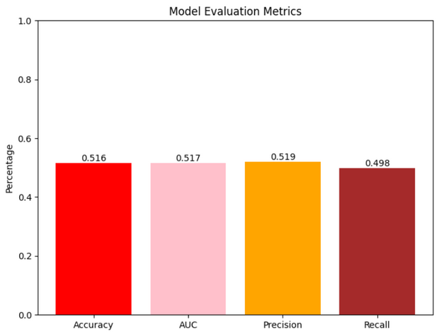
Models
Logistic Regression
SVC

Slide 26
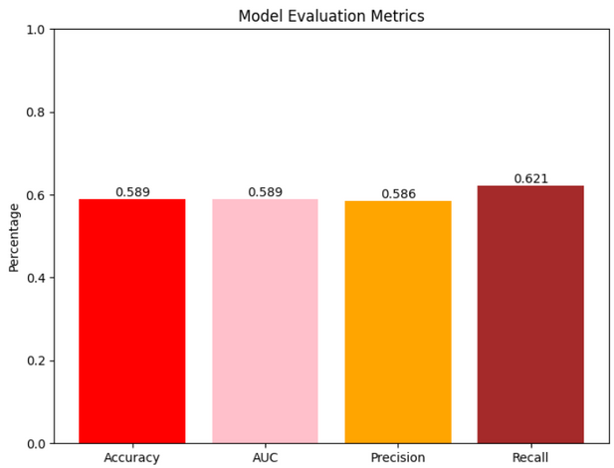
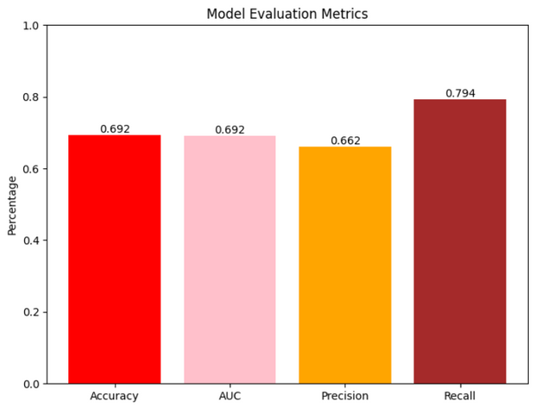
Models
KNN
Decision Tree

Slide 27
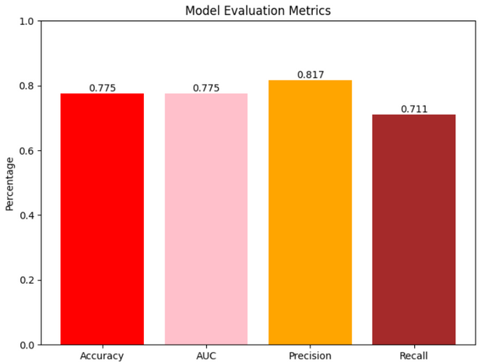
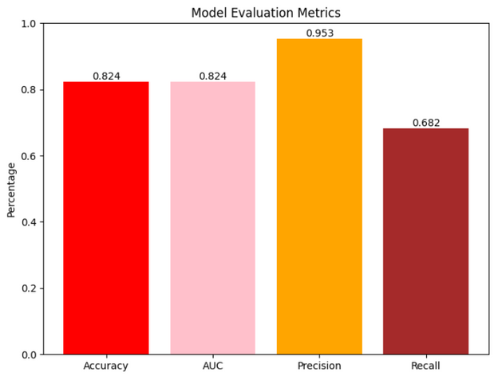
Models
XGBoost
Random Forest

Slide 28
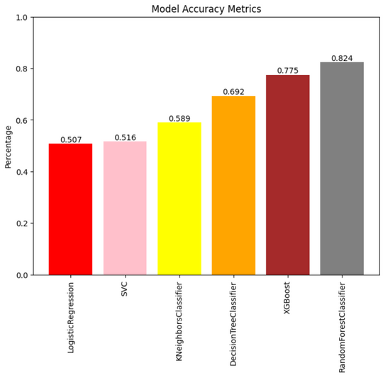
The Best Accuarcy
Random Forest Classifier method

Slide 29
DEPLOYMENT

Slide 30
Why Streamlit?
Simple to use and integrates well with machine learning libraries like ( scikit-learn ).
Requires no front-end experience.
Fast prototyping of data science and machine learning models.

Slide 31
Key Features of Streamlit
User-Friendly Interface
Build interactive web apps using Python only.
Live Updates
Automatically updates the app when the code changes.
Interactive Widgets
Supports sliders, buttons, and inputs to allow dynamic interactions.

Slide 32
Steps of Deployment Using Streamlit
1- Train Your Model
Create and train a model using libraries like scikit-learn.
Save the model ( using pickle ).
2- Install Streamlit and Create a Python Script
pip install streamlit
Import necessary libraries (Streamlit, Pandas, pickle).
Load the trained model.
Create a function for model predictions.

Slide 33
Steps of Deployment Using Streamlit
3- Add Interactive Features
Use widgets (streamlit.slider(), streamlit.selectbox()) to allow user input.
Process the input to be compatible with the model.
4- Display Predictions
Output the prediction using st.write() or other display methods.
Run the App Locally (streamlit run prodeployment.py run locally using the terminal -> (Cloud)

Slide 34
Advantages of Streamlit for Deployment
Fast and Easy Deployment.
No Front-End Experience Required.
Allows users to interact with the machine learning model via sliders, dropdowns, and text input.

Slide 35
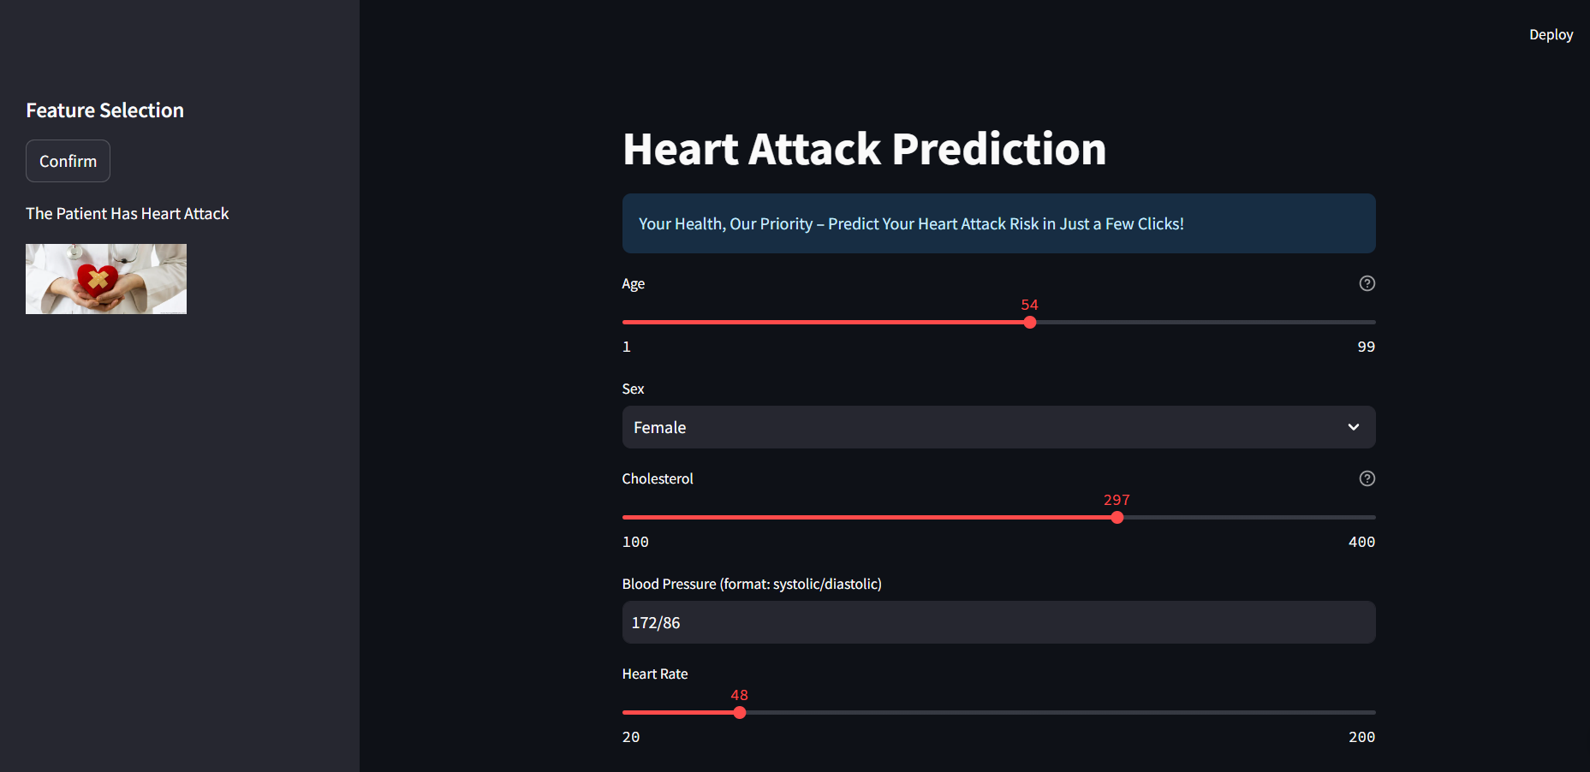

Slide 36
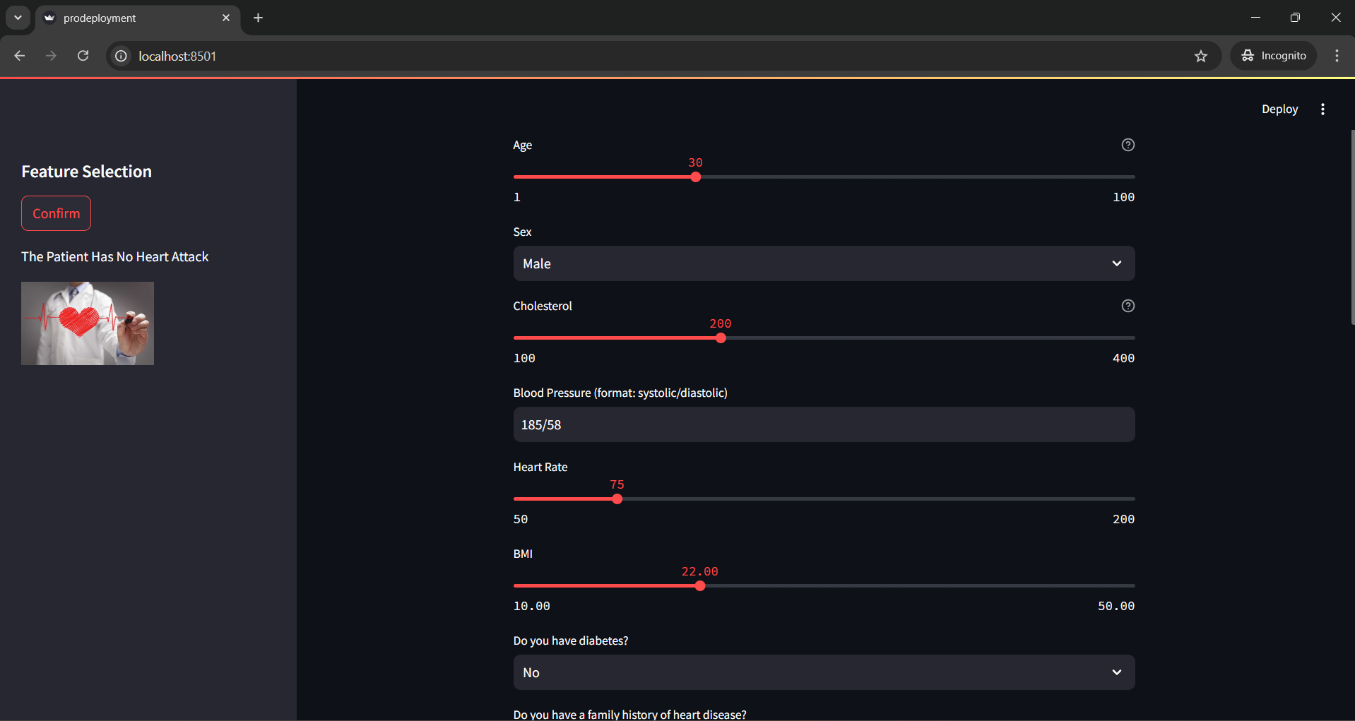

Slide 37

THANK
YOU !

